Slide 1



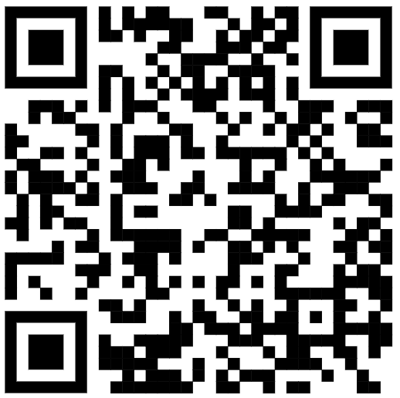
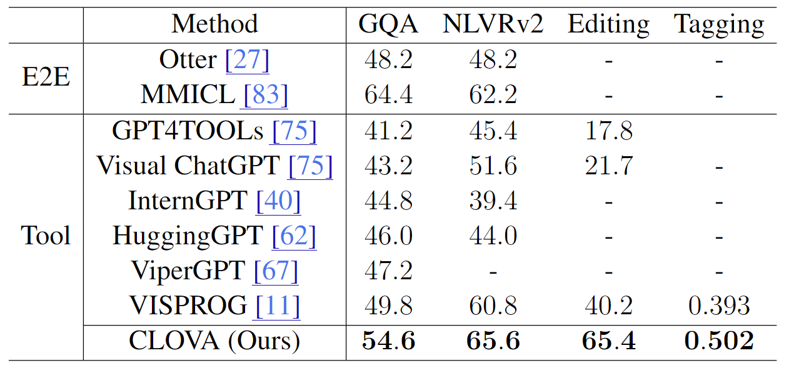
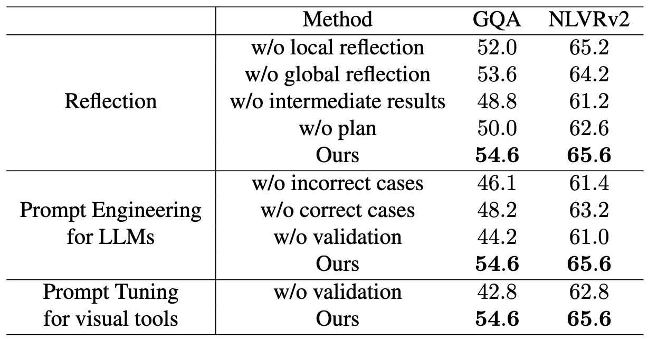
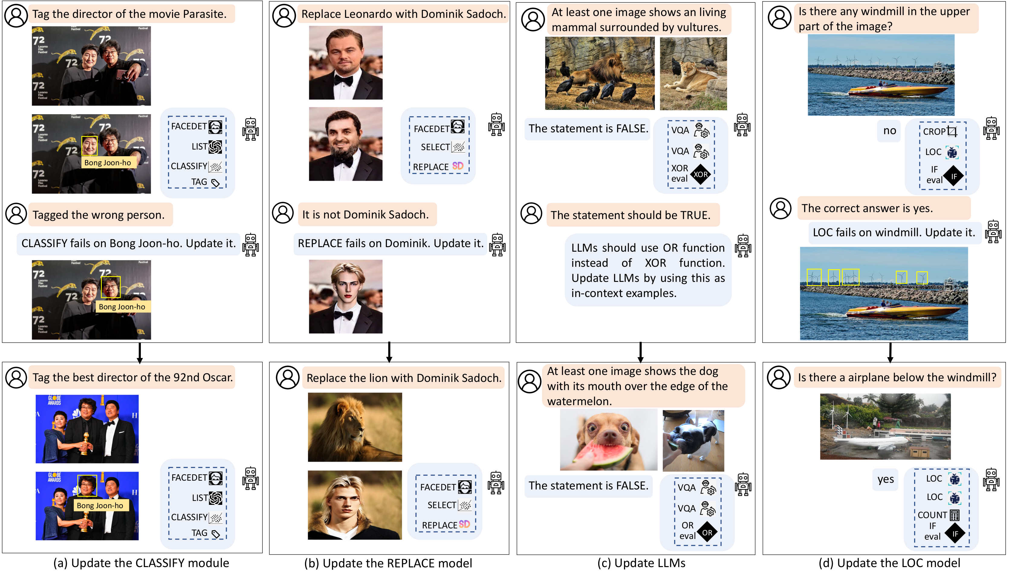
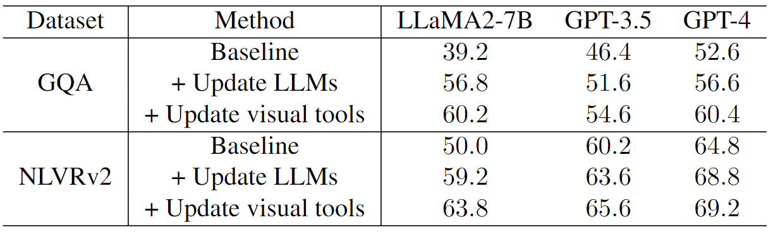
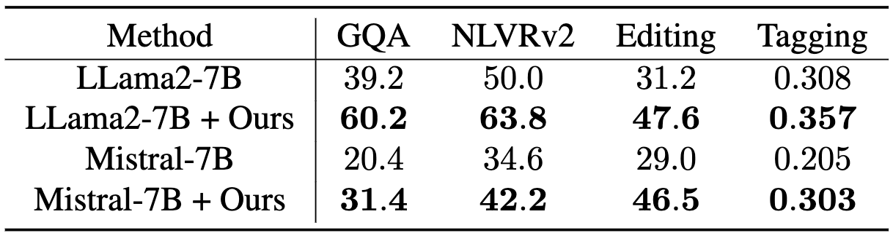
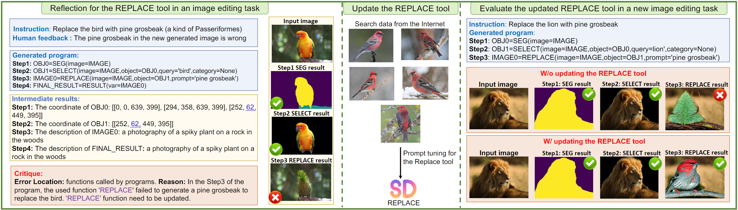
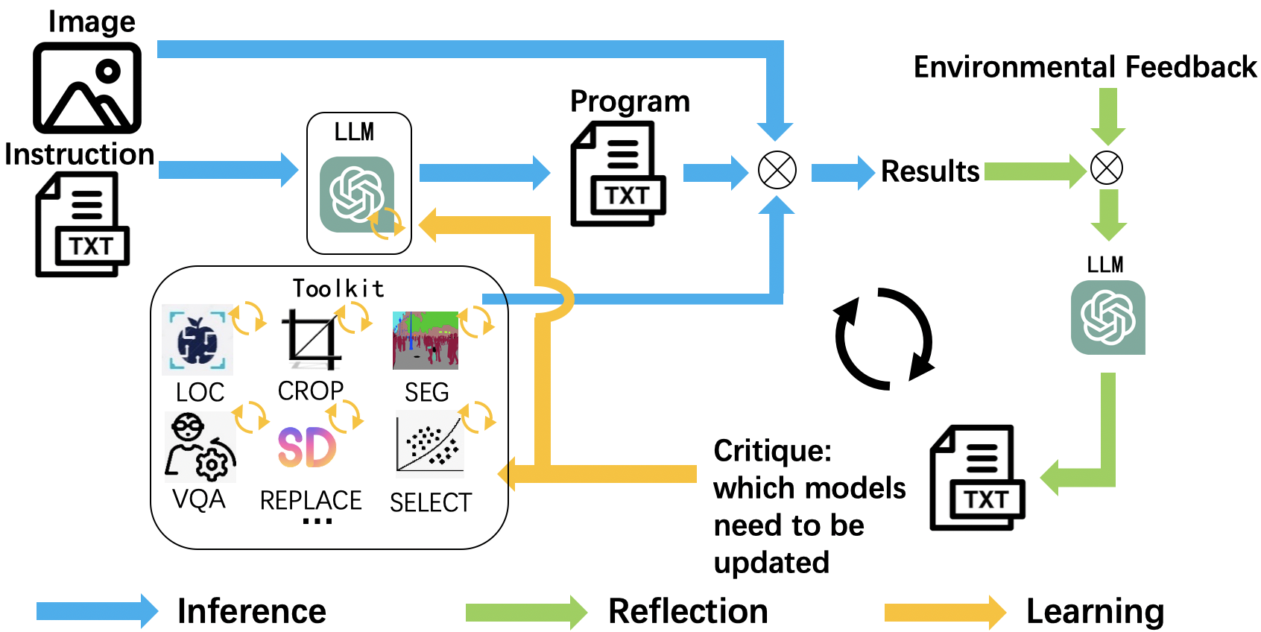
CLOVA: A Closed-Loop Visual Assistant with Tool Usage and Update Zhi Gao, Yuntao Du, Xintong Zhang, Xiaojian Ma, Wenjuan Han, Song-Chun Zhu, Qing Li
Project
Introduction
CLOVA = Inference + Reflection + Learning
Experiments
Motivation: Can VLM improve from user’s feedback?
Main results
Ablation studies
Inference
Different LLMs
Reflection
Quantitative observation:
CLOVA achieves SOTA among tool-usage VLMs.
CLOVA is robust to different LLMs, including open and closed ones.
Update both LLM and visual tools bring significant improvements.
Challenges: (1) how to diagnose errors? (2) how to collect training data? (3) how to efficiently update the model?
Qualitative example
Proposal: CLOVA = Inference + Reflection + Learning
improve from feedback via a closed-loop learning framework
Learning
Takeaway Message
We build CLOVA, the first VLM that can improve from feedback via a closed-loop learning framework with inference, reflection, learning phases.
Use both correct and incorrect examples for prompts to generate plans & programs.
Propose a global-local reflection scheme to diagnose errors.
Apply hard/soft prompt tuning to update tools with limited data.
Code & Examples: clova-tool.github.io
Notes:
We aim to empower tool-usage visual assistants the ability of continual learning. We hope the assistant could automatically update its tools based on human feedback.
1

